Slide 1
CSC 314
OPERATING SYSTEMS I

Slide 2
GROUP 5
1. MUMUNI ABDULLAH 180805047
2. OLORUNFEMI-OJO TOMIWA 190805503
3. ANIMASHAUN SOFIAT 190805520
4. OGUNRINDE MOTUNRAYO 190805514
5. ADEMUYIWA ABDULBAQI 190805522

Slide 3
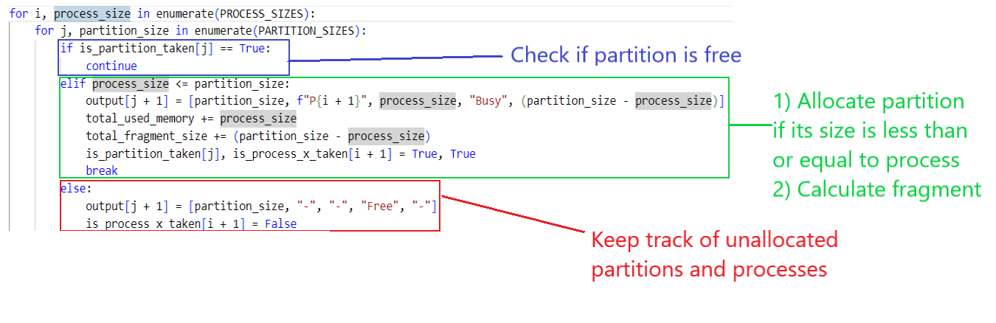
FIRST FIT MEMORy ALLOCATION SCHEME

Slide 4
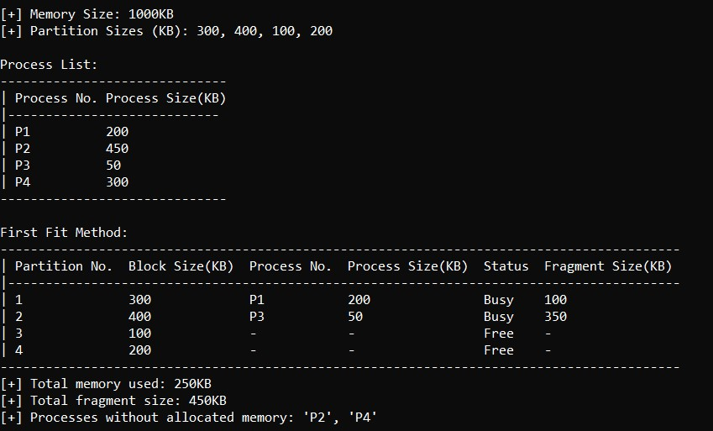
FIRST FIT Memory ALLOCATION SCHEME (DEMO)

Slide 5
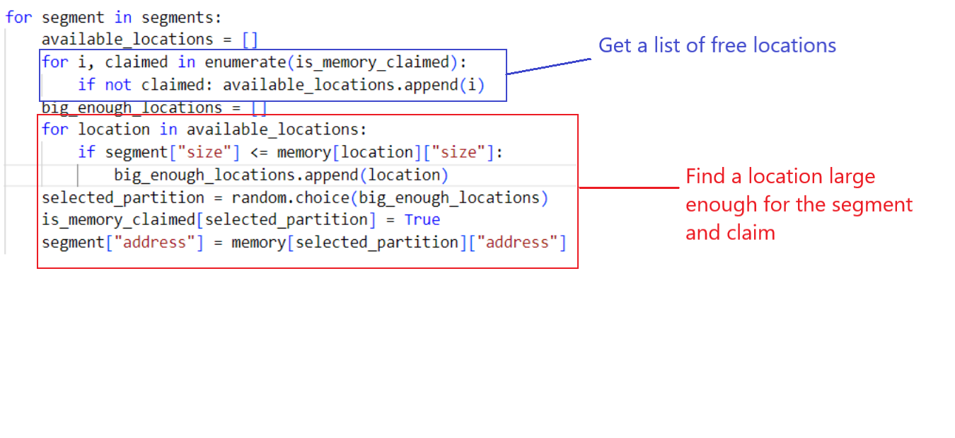
SEGMENTED Memory allocation

Slide 6
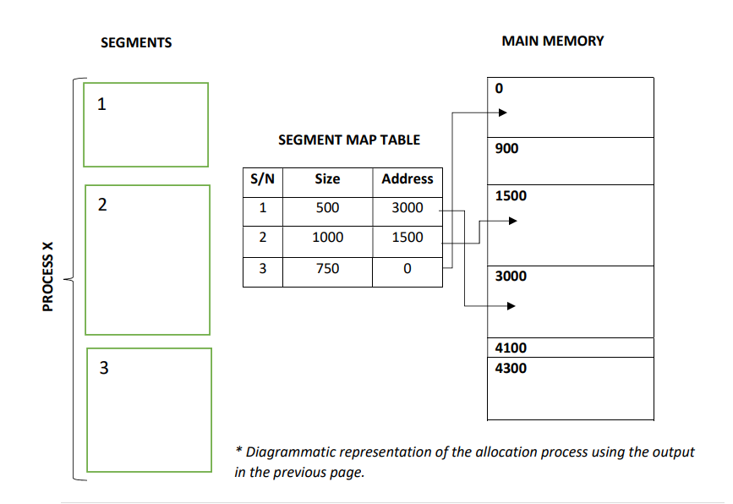
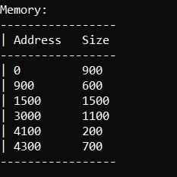
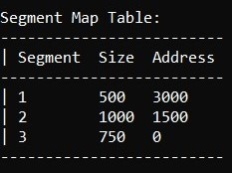
Segmented memory allocation demo

Slide 7
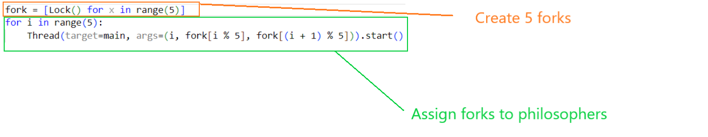
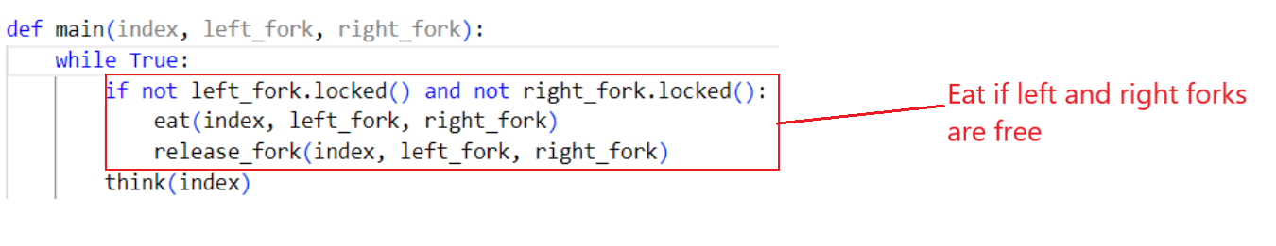
Dining philosophers problem
Assign Forks
Attempt eating

Slide 8

DINING philosophers problem demo

Slide 9
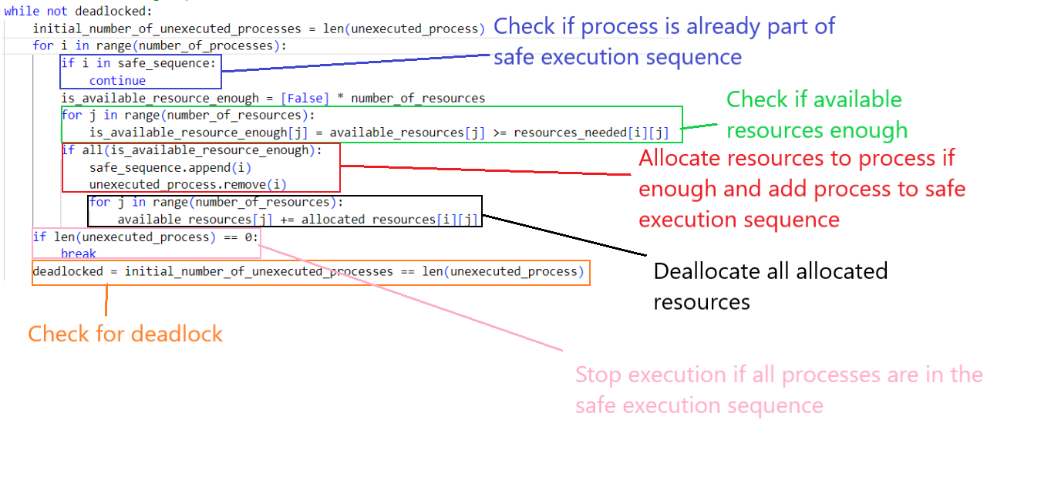
BANKERS ALGORITHM

Slide 10
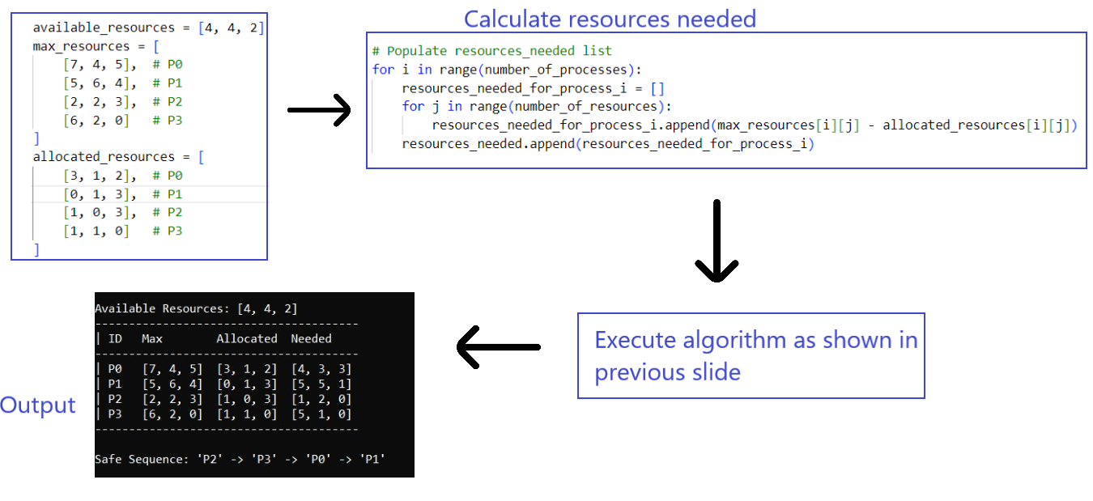
BANKERS ALGORITHM DEMO

Slide 11
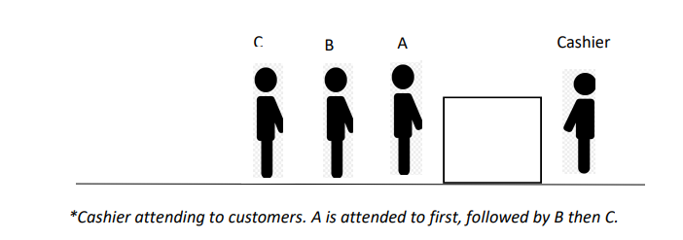
Process scheduling algorithms
First Come First Serve

Slide 12
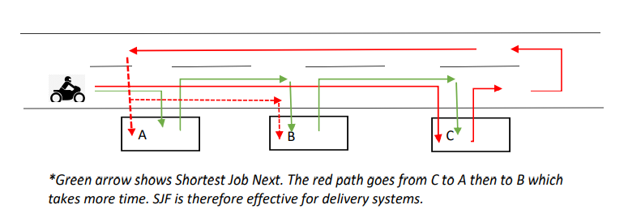
Process scheduling algorithms
Shortest Job First

Slide 13
Process scheduling algorithms
Priority Scheduling
Example: BODMAS
𝑥 = 2 × 4 + 8 ÷ (9 − 5)
𝑥 = 2 × 4 + 8 ÷ 4
𝑥 = 2 × 4 + 2
𝑥 = 8 + 2
𝑥 = 10

Slide 14
Process scheduling algorithms
Shortest Time Remaining
SRT can be observed at an accident scene. For example, two vehicles collide and several people are injured. Death is most likely to catch up with the most severely injured person because such an individual has the shortest time remaining to live. The more the severity of the injury, the shorter the time remaining to live. In this analogy, death represents the processor executing a process.

Slide 15
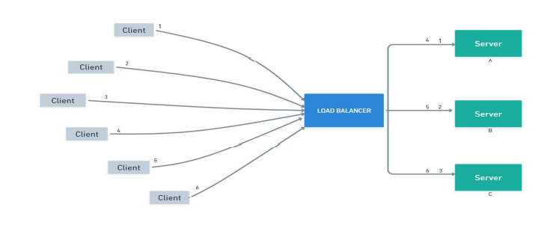
Process scheduling algorithms
Round Robin

Slide 16
Process scheduling algoritms
Multiple Level Queues
Real life example of Multi level Queue usage is in a manufacturing company. Let's say we have a machine that can be used to produce many different types of product. The machine must be setup when changing over from one product type to another. We want to minimize the time lost to setup (minimize the changeovers from one product to another) but still deliver orders on time. A multi-level queue approach is to group orders for the same product. We cannot keep adding orders to the first queue, as then orders in the other queues will be late, so at some point we will start adding orders of that type to a new queue with lower priority. We may also have some high priority queues for “rush” orders.

Slide 17
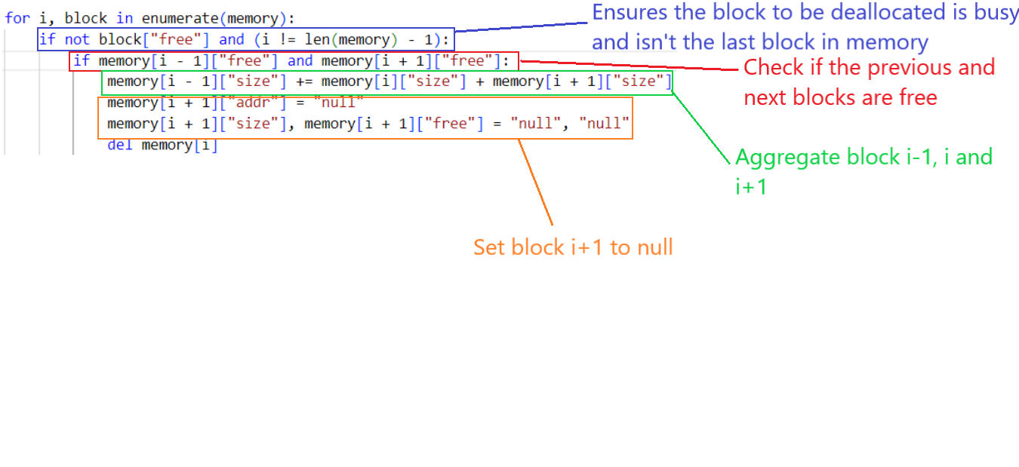
Deallocation: when block to be deallocated is b/w 2 free blocks

Slide 18
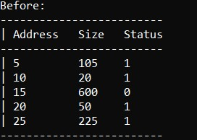
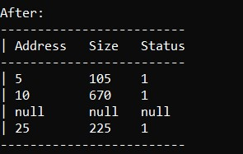
DEALLocation demo

Slide 19

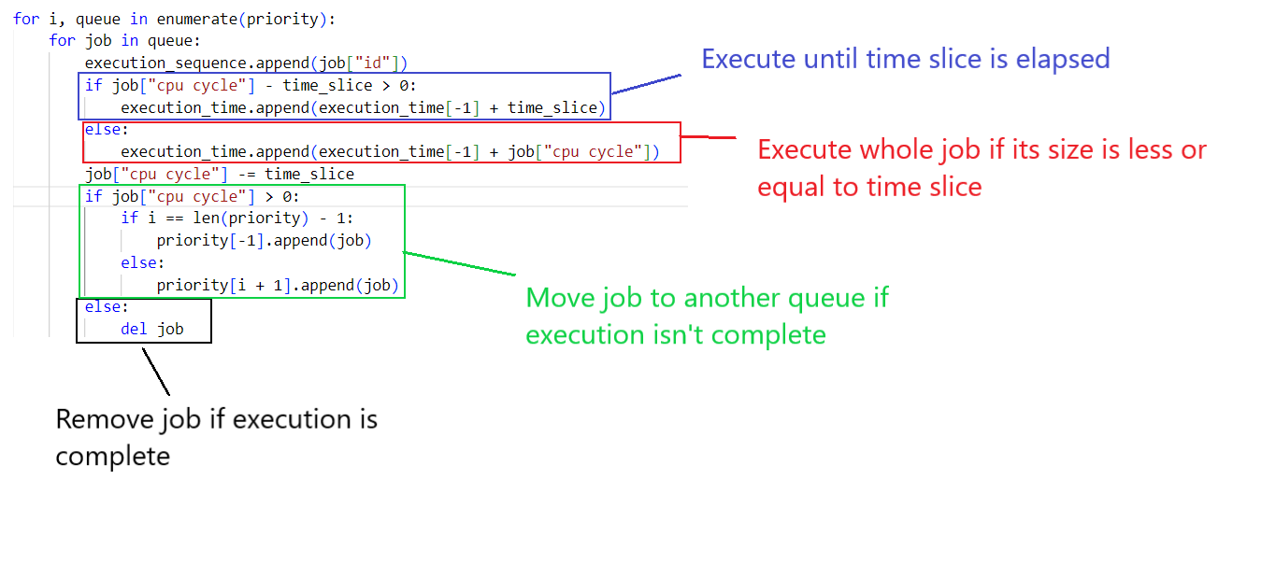
Multiple level queues
No movement b/w queues
Movement b/w queues

Slide 20
Multiple level queues
Variable time quantum per queues
Double time slice

Slide 21
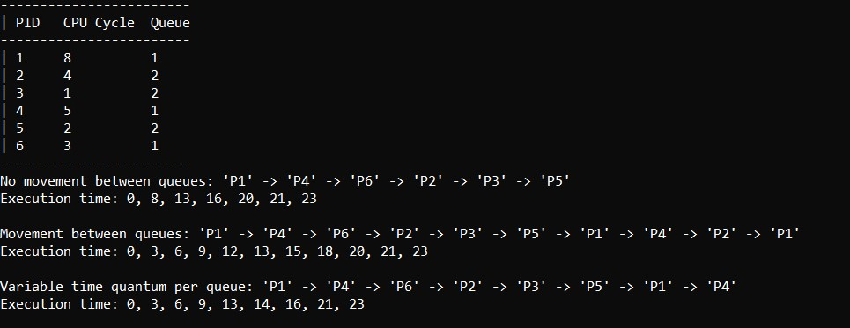
Multiple level queues demo

